Slide 1
Secure Data Hiding in Image Using Steganography
Presented By:
Student Name : VARSHINI G S
College Name & Department : AMRITA VISHWA VIDYAPEETHAM - COIMBATORE
ELECTRICAL AND ELECTRONICS ENGINEERING

Slide 2
OUTLINE
Problem Statement
Technology used
Wow factor
End users
Result
Conclusion
Git-hub Link
Future scope

Slide 3

Problem Statement
Data privacy is a growing concern in digital communication.
Traditional encryption methods are effective but can be easily detected.
Steganography allows hiding encrypted data inside images, ensuring confidentiality and reducing detection risks.
Cybercriminals use advanced techniques to intercept sensitive information, making secure data transmission crucial.

Slide 4
Technology used
Programming Language: Python IDLE
Operating System: Windows 11
Libraries Used:
OpenCV – Image processing and manipulation
NumPy – Handling binary and pixel data efficiently
Pillow (PIL) – Image handling and conversion
Cryptography – for encrypting and securing hidden pages

Slide 5
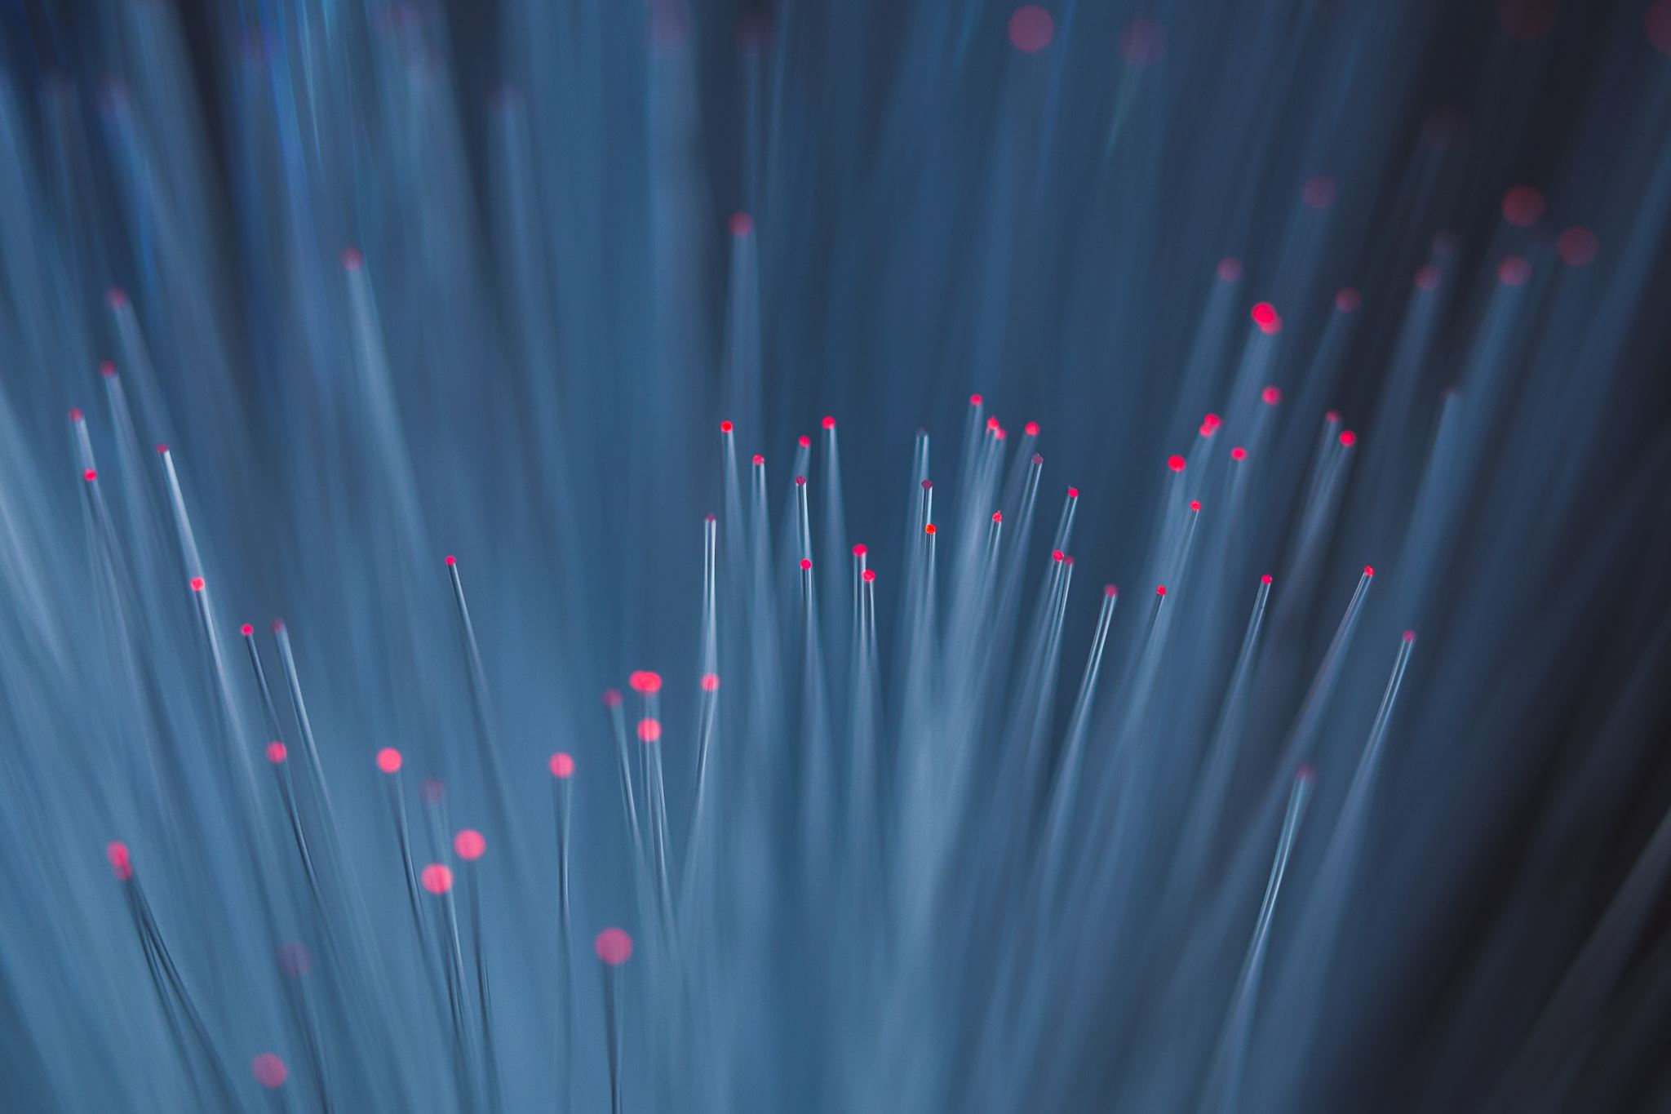
Wow factors
Dual Security: AES encryption before embedding ensures confidentiality.
Highly Imperceptible: No visible changes in the image after embedding.
Resistant to Steganalysis: Prevents detection by attackers.
Scalability: Can be extended to audio/video steganography.

Slide 6

End users
🔹 Government Agencies – Secure confidential communication. 🔹 Cybersecurity Professionals – Research & implementation. 🔹 Companies – Protect sensitive business data. 🔹Individuals – Private messaging with hidden encryption.

Slide 7
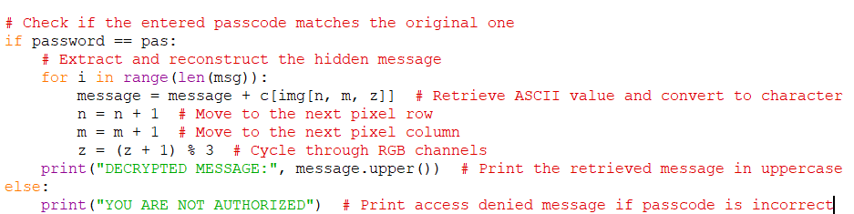
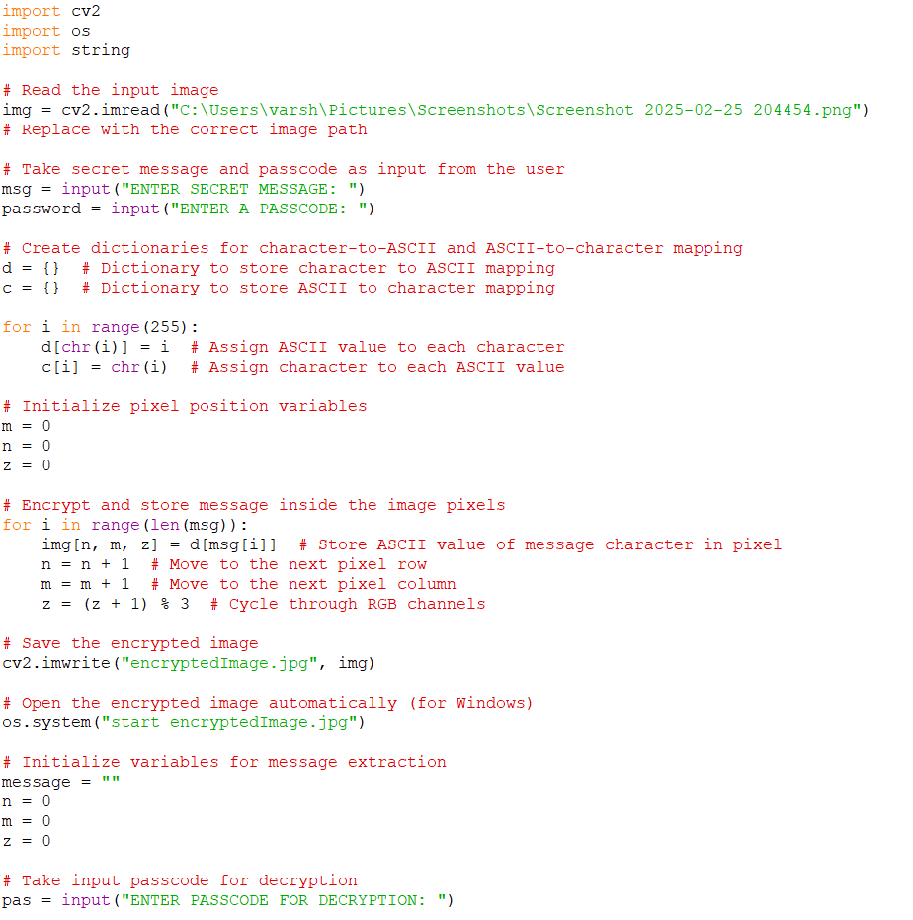
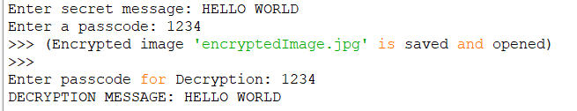
Results

Slide 8

Conclusion
Successfully implemented AES-encrypted LSB steganography.
Ensures secure data hiding with minimal visual distortion.
Offers strong security against unauthorized access.
Can be extended to other media types for enhanced protection

Slide 9

GitHub Link
https://github.com/Varshini-svg/PROJECT-STEGNOGRAPHY.git

Slide 10

Future scope(optional)
Implement AI-based steganography for adaptive security.
Extend the project to video & audio steganography.
Develop a mobile app for secure steganographic messaging.

Slide 11
THANK YOU

